Slide 1
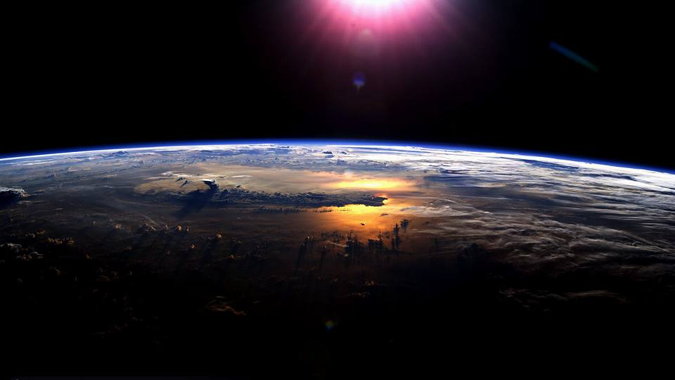


Steam Propulsion for Interplanetary Spacecraft using Solar Enabled Carbon Nanoparticles Nathan Barba – ASU Mechanical Engineering Mentor: Dr. Jekan Thanga 2016 NASA Space Grant Symposium

Slide 2
Summary
Concentrated light combined with carbon nanoparticles in liquid water causes high speed steam generation.
The steam generated can be used to extract vapor from water-bearing regolith.
The system is simple and uses no moving parts.
The steam released can also be used to create thrust using a rocket nozzle.
Source: “Solar Vapor Generation Enabled by Nanoparticles Halas, et al. 2013

Slide 3
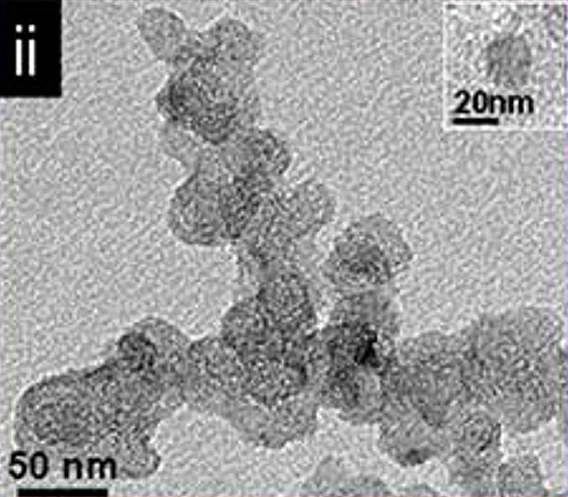
Carbon Black Nanoparticles
Donation of 1kg of N115 Carbon Black Nanoparticles by Cabot Labs
Made of charcoal grinded to 115 nm
Other nanoparticles, such as gold, also has same effect in liquid water.

Slide 4
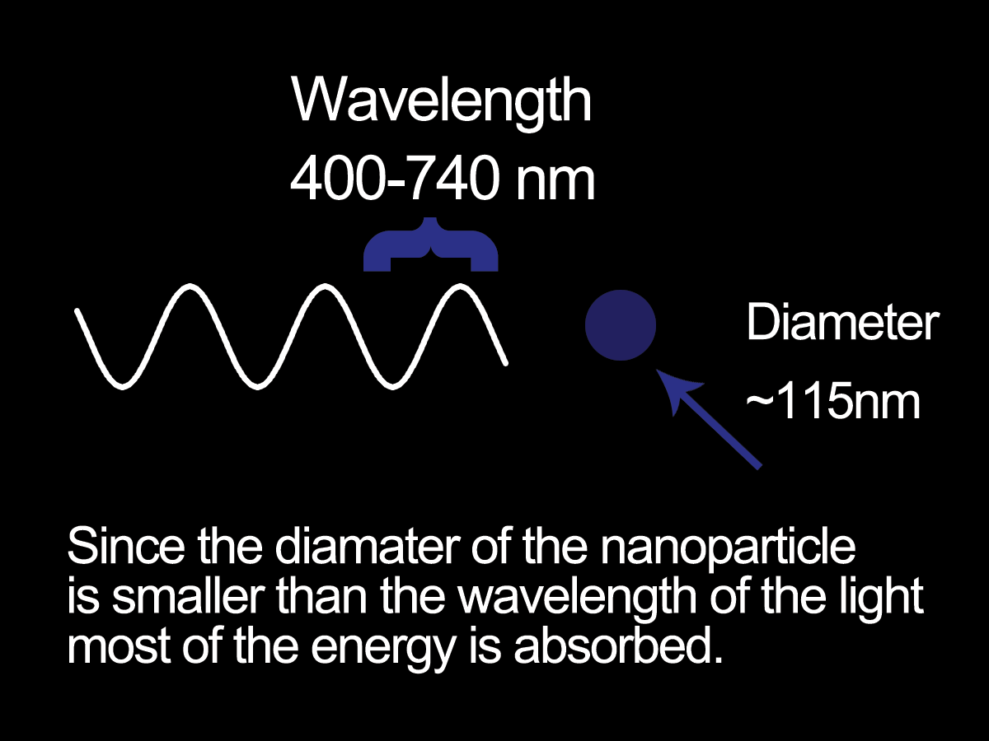
How does it work?
Concentrated light is absorbed due to subwavelength geometry
Steam bubble is initially created, allows steam to rise and create thermal barrier reducing thermal conductance.
Nanoparticle2 remain in fluid.
82% direct energy conversion from solar radiation to steam.

Slide 5
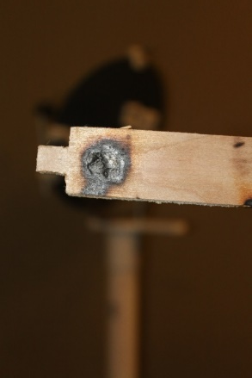
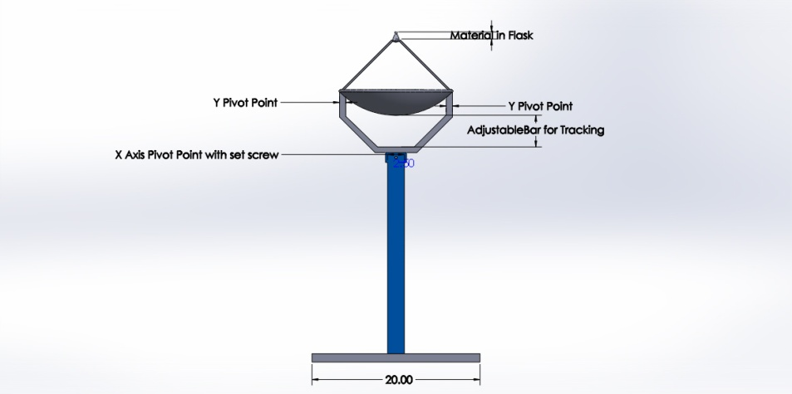
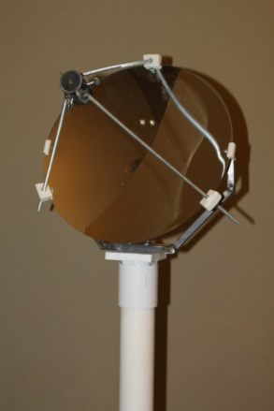
3-D Solar Concentrator Specs
13” Collector
Max Power = 85W
Max Concentration = 3000 times
Max Temp observed = 747.5 °C / 1377 °F

Slide 6
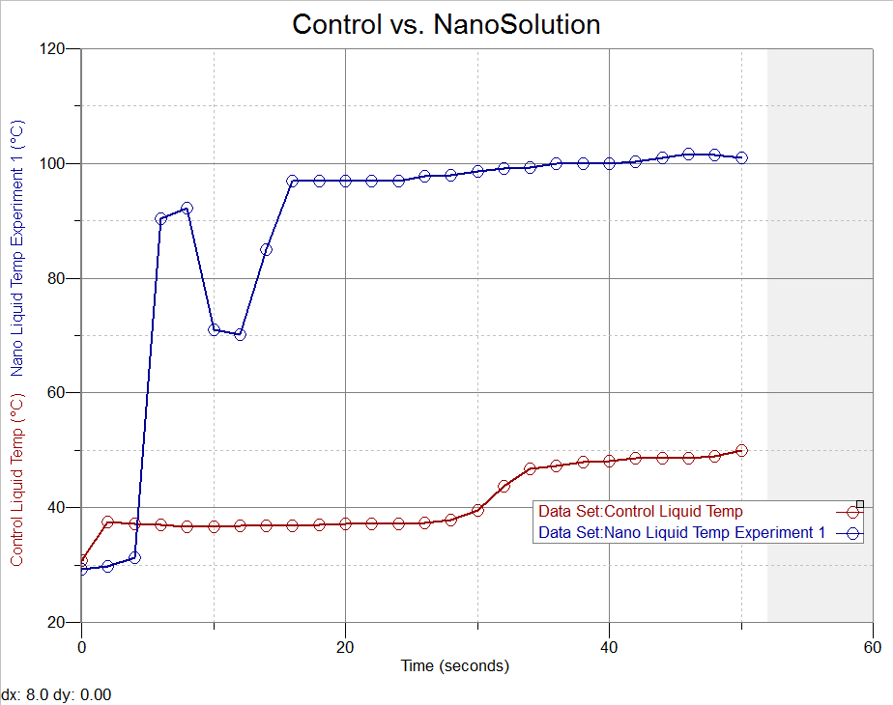
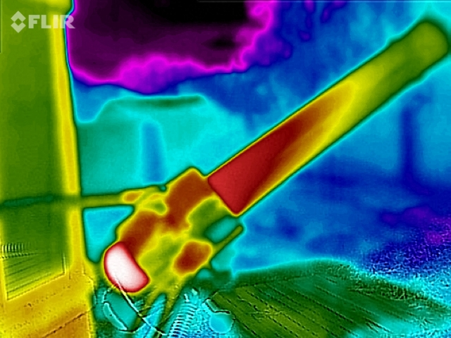
Initial Results

Slide 7
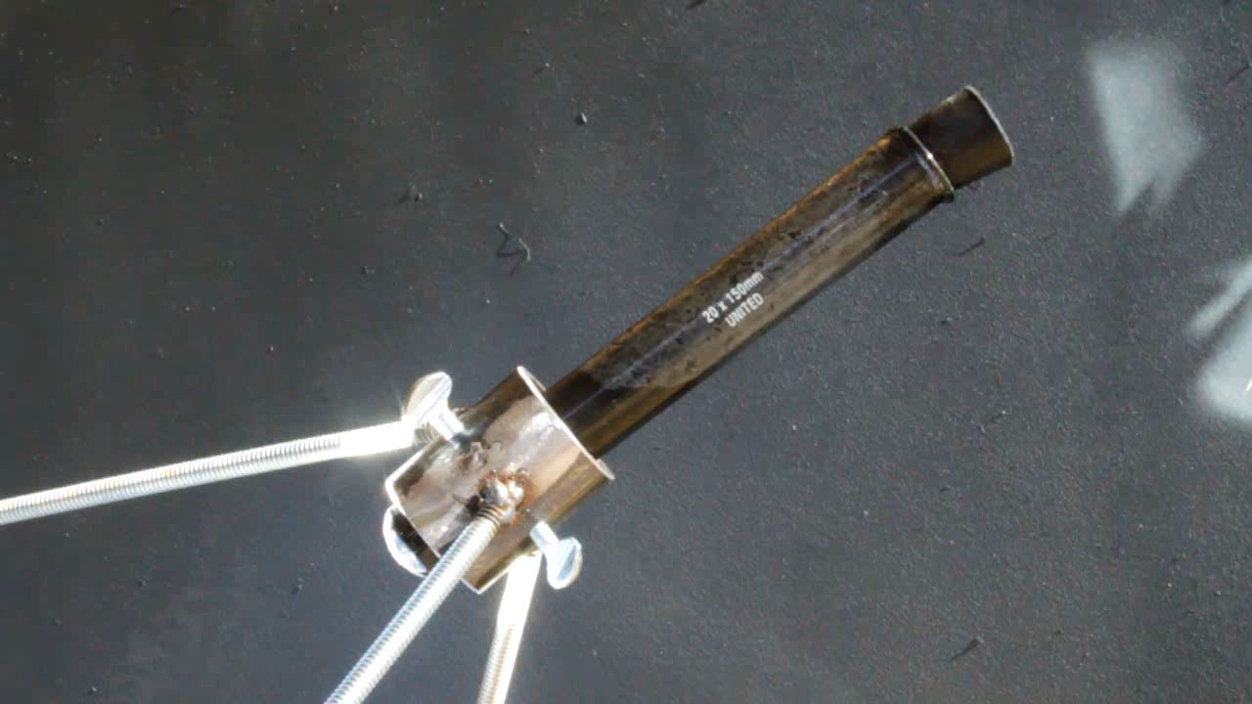
Initial Results

Slide 8
Space Applications
Use heat from solar collector and nanoparticles to extract water vapor from regolith.
Use steam as propulsion system for low gravity environments.
Waste heat from nanofluid can be used to produce electricity and warm up electronics.
Use heat to melt ground ice and collect sample.

Slide 9
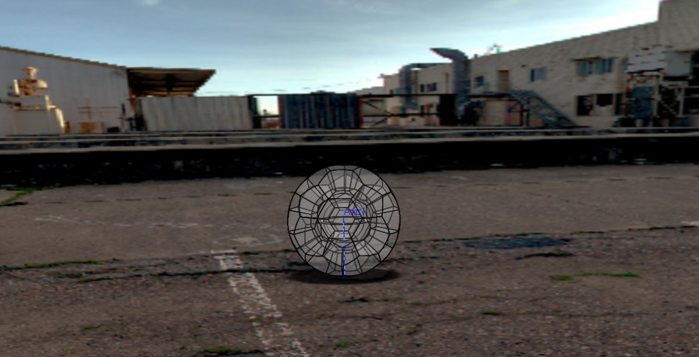
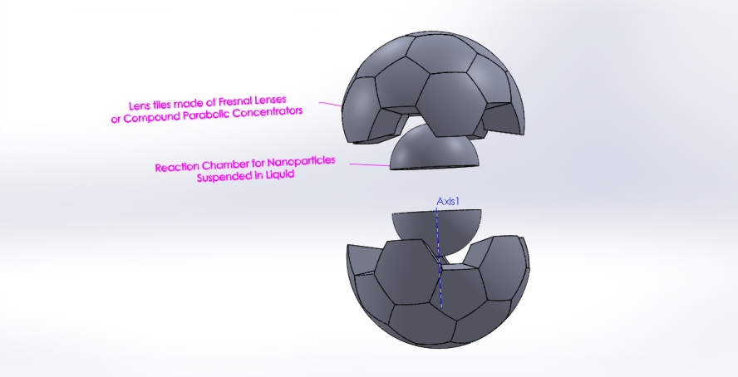
Steam Powered Pitbot Design Prototype
Spherical robot surrounded with Fresnel lenses.
Utilizes concentrated sun and nanofluid to produce steam that causes it to roll or even hop.

Slide 10
Benefits of Steam Propulsion
No moving parts, uses free energy source.
Fuel doesn’t need to come from Earth.
In-Situ utilization of water from asteroid regolith by heating and using nanoparticles.
Water can also be processed for other uses once extracted.
Properties of steam very well understood.
No dangerous or harmful chemicals.
Heat produced can also be for cogeneration.
Steam can produce Isp = 200 s when heated to 2000 C. (comparable to current monoprop chemical propulsion methods)

Slide 11




Thank you!
Special thanks to:
ASU NASA Space Grant
NASA
Dr. Jekan Thanga
Space and Terrestrial Robotic Exploration Laboratory (SpaceTREx)
Cabot Corporation
ASU
SpaceTREx

Slide 12
Questions
Nathan Barba Mechanical Engineering
Nathan.Barba@asu.edu

